Slide 1
Secure Data Hiding in Image Using Steganography
CAPSTONE PROJECT
Presented By: IBM
Student Name : Aniket Santosh Rasal
College Name & Department : Sinhgad College of Engineering/Computer Engineering

Slide 2
OUTLINE
Problem Statement
Technology used
Wow factor
End users
Result
Conclusion
Git-hub Link
Future scope

Slide 3
Problem Statement
With increasing digital communication, data security is a major concern. Traditional encryption methods can alert attackers to sensitive information. Steganography offers a covert way to hide data within images, ensuring confidentiality without raising suspicion. This project aims to develop a secure and efficient method for embedding and retrieving hidden data in images.

Slide 4
Technology used
Programming Language: Python
Libraries: OpenCV, NumPy, PIL (Pillow)
Encryption Algorithm: AES (Advanced Encryption Standard) for added security
Steganography Technique: LSB (Least Significant Bit) encoding

Slide 5
Wow factors
Dual-layer security: Encryption + Steganography
High imperceptibility: The hidden data is undetectable by the human eye
Minimal distortion: Image quality remains nearly unchanged
User-friendly interface for embedding and extracting hidden data

Slide 6
End users
Journalists and whistleblowers who need secure communication
Military and intelligence agencies for covert data transmission
Researchers handling confidential intellectual property
Everyday users wanting to protect personal data

Slide 7
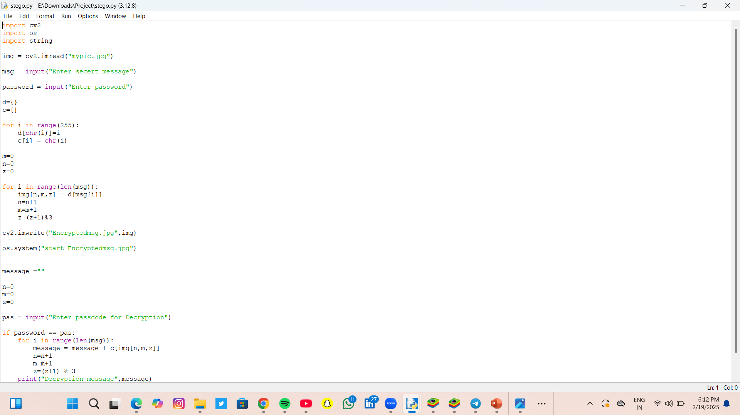
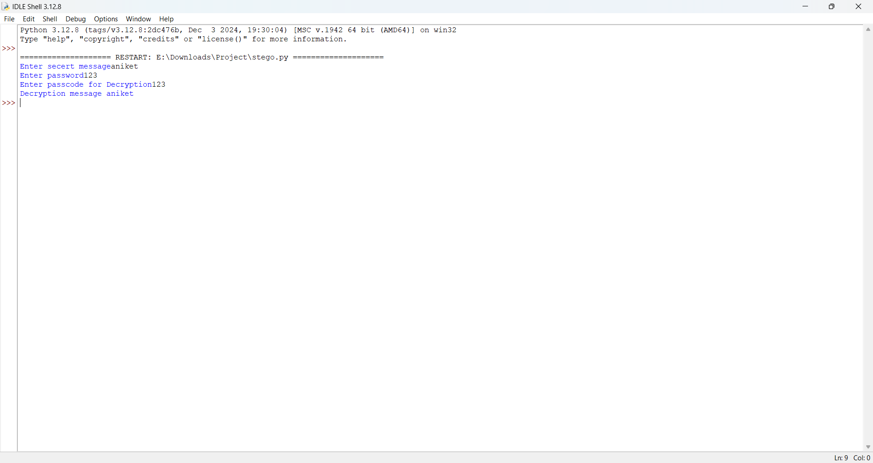
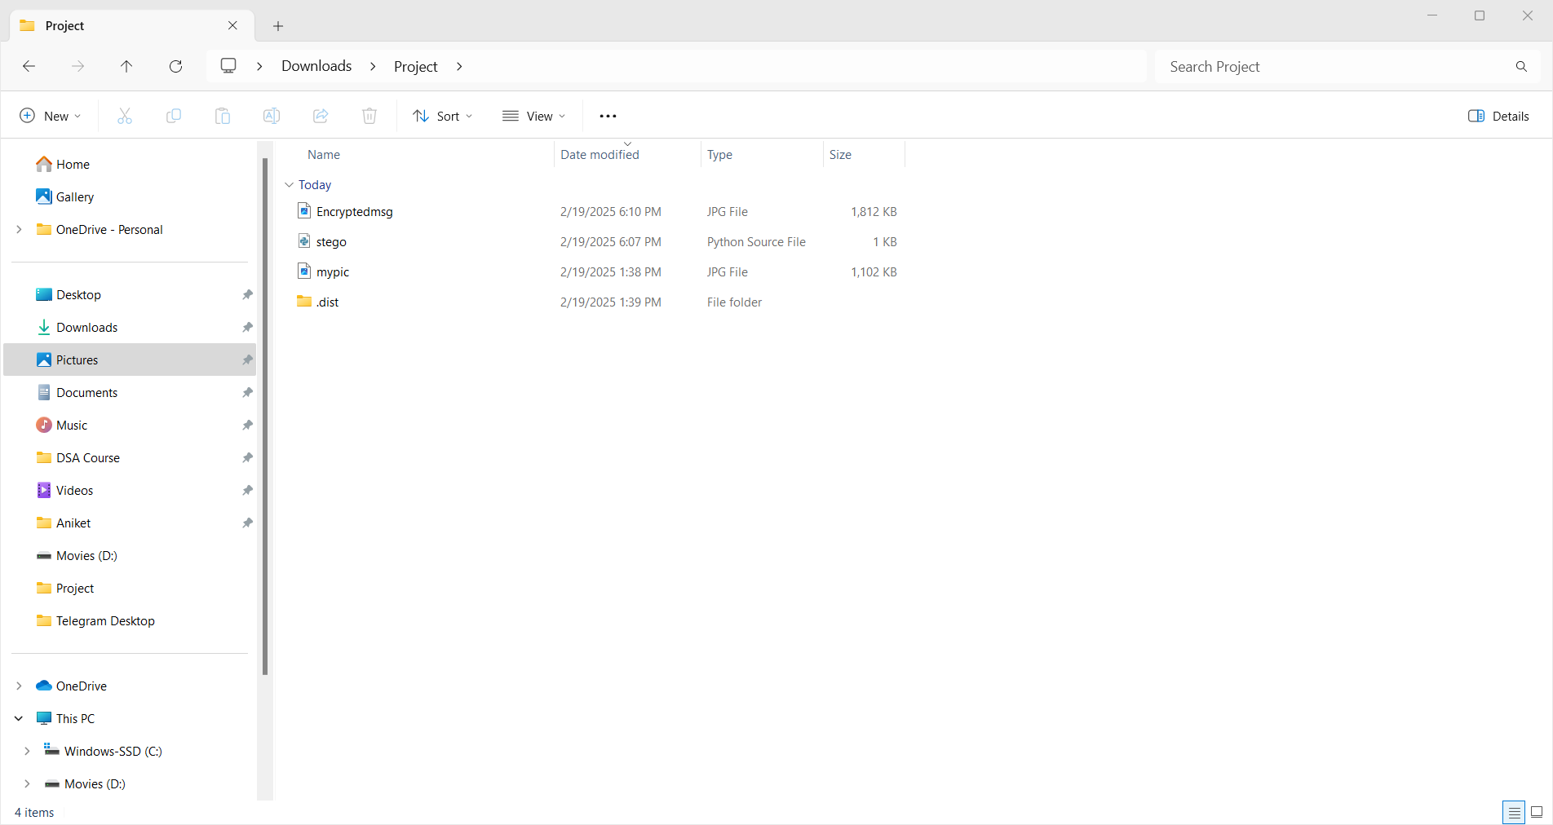
Results

Slide 8
Conclusion
This project demonstrates the effectiveness of steganography in enhancing digital security. By combining encryption and LSB-based data hiding, it ensures a highly secure method of covert communication. Future improvements can enhance capacity, resistance to attacks, and support for various file formats.

Slide 9
GitHub Link
https://github.com/Aniket1845/myproject_stenography.git

Slide 10
Future scope(optional)
Implementing deep learning techniques for adaptive steganography
Supporting video and audio steganography for broader applications
Enhancing resistance against steganalysis attacks
Developing a mobile application for easy accessibility

Slide 11
THANK YOU

